Slide 1
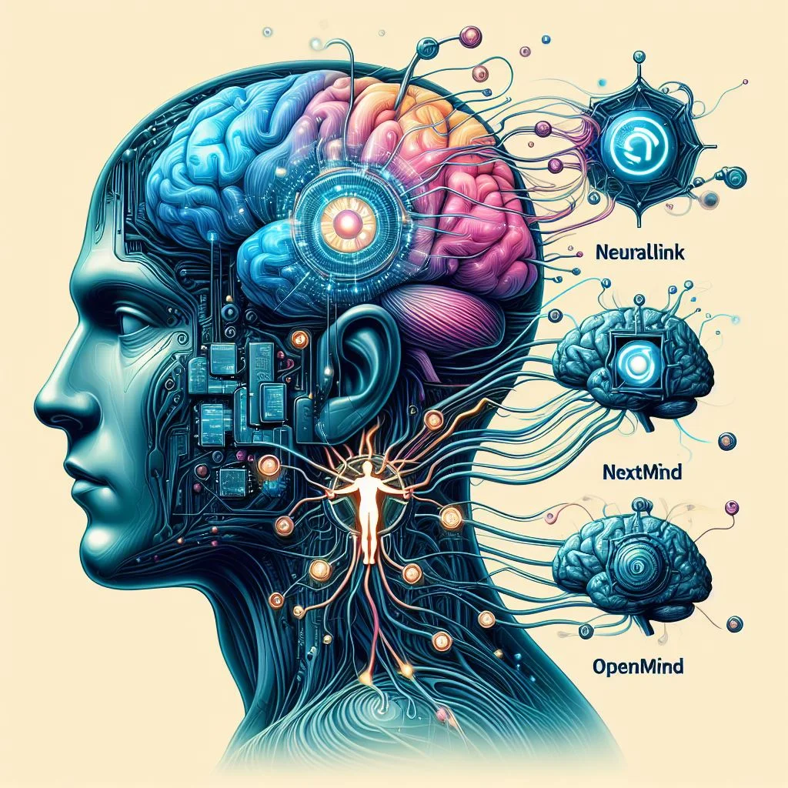
MULTI-MODAL INTEGRATION OF EEG- FNIRS USING DATA AUGMENTATION CGAN
GUIDED BY DR.T.JAYASHANKAR
TEAM MEMBERS
SARAVANAN K
SYED RABIYATHUL BASARIYA S M PRIYADHARSHINI J
810021106069
810021106085
810021106722

Slide 2
OBJECTIVE :-
We propose a novel approach to augment multi-modal EEG-fNIRS data using Conditional Generative Adversarial Networks (CGAN). By leveraging the complementary information from EEG and fNIRS signals, our CGAN- based framework generates synthetic data that preserves the underlying brain activity patterns.
Experimental results demonstrate the effectiveness of our approach in enhancing data diversity, improving model generalization, and reducing overfitting. This work has significant implications for brain-computer interface (BCI) research, enabling more accurate and robust analysis of brain activity.

Slide 3
INTRODUCTION :-
The integration of multiple neuroimaging modalities, such as electroencephalography (EEG) and functional near-infrared spectroscopy (fNIRS), has shown great promise in enhancing our understanding of brain function and behavior.
By combining the strengths of EEG's high temporal resolution and fNIRS's ability to measure hemodynamic responses, multi-modal integration can provide a more comprehensive understanding of cognitive processes.

Slide 4
INTRODUCTION :-
Data augmentation techniques offer a potential solution to the challenge of limited data availability. By generating synthetic data that mimics the characteristics of real data, data augmentation can increase the size and diversity of the training dataset, improving the performance and generalizability of machine learning models.
This research explores the integration of EEG and fNIRS data using data augmentation techniques to enhance the accuracy and robustness of cognitive state assessment and brain-computer interface (BCI) systems.
By leveraging the complementary information provided by EEG and fNIRS, and augmenting the dataset with synthetic samples, this research aims to develop more accurate, robust, and generalizable models for a wide range of cognitive research and technology applications.

Slide 5
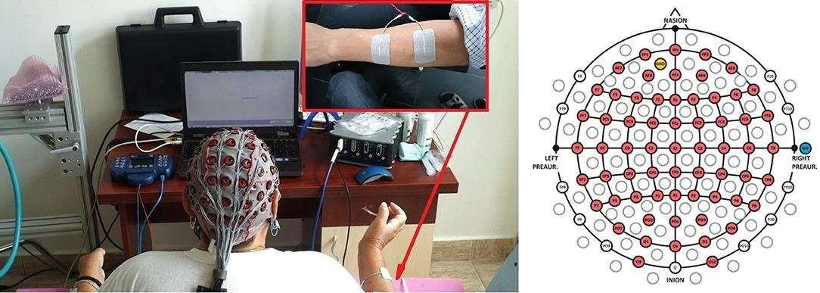
EXPLANATION OF IMPORTANT TERMS :-
MOTOR IMAGERY :-
Motor Imagery (MI) is the mental process of imagining a specific movement of a part of the body without actually performing the movement. During MI, the brain activates motor-related regions in a way similar to actual physical movement, even though no real muscle activity occurs.

Slide 6
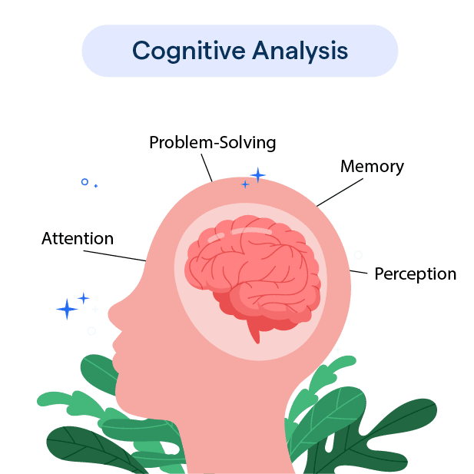
COGNITIVE TASKS :-
Cognitive" refers to mental processes like thinking, learning, and understanding. It encompasses various abilities and functions, including perception, memory, judgment, and reasoning. In essence, cognitive refers to the way our minds work to acquire, process, and use information.

Slide 7
Cognitive Task :-
Think
Learn
Remember
Problem-solve
Perceive
Understand Cognition
involves various brain functions, including:
1. Attention
2. Memory
3. Language
4. Reasoning
5. Decision-making Cognitive abilities are essential for daily life, enabling us to process information, adapt to situations, and interact with the world around us.

Slide 8
EEG (Electroencephalogram) :-
EEG stands for Electroencephalography. It's a neurophysiological measurement technique that records electrical activity in the brain through electrodes placed on the scalp.
EEG is used to:
Diagnose and monitor neurological disorders (e.g., epilepsy, seizures)
Study brain function and activity
Investigate sleep patterns and disorders
Develop brain-computer interfaces (BCIs)EEG measures electrical signals produced by brain activity, providing insights into brain function and behavior.

Slide 9
FNIRS :-
Functional Near-Infrared Spectroscopy (fNIRS) is a non-invasive brain imaging technique that measures changes in blood oxygenation levels in the brain.
It uses near-infrared light to detect:
Oxygenated hemoglobin (HbO)
Deoxygenated hemoglobin (HbR)
fNIRS is used to:
Study brain activity and function
Monitor cognitive processes (e.g., attention, memory)
Investigate neurological disorders (e.g., stroke, Alzheimer’s)
Develop brain-computer interfaces (BCIs)fNIRS offers advantages like portability, low cost, and minimal setup compared to other neuroimaging methods.

Slide 10
Multimodal fusion:
Combining data from multiple sources or modalities to improve accuracy, robustness, or user experience.
Examples of multimodal systems include:
Voice assistants with visual feedback
Gesture-based interfaces with audio feedback
BCIs that use EEG and eye-trackingMultimodal systems can enhance user experience, improve accessibility, and increase interaction flexibility.

Slide 11
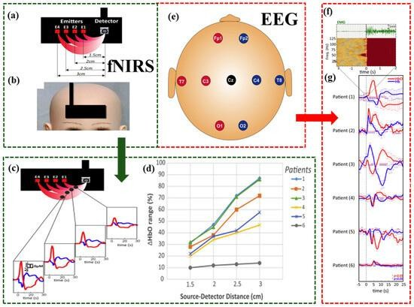
MULTI MODAL INTEGRATION :-
Multimodal refers to the use of multiple modes or channels of communication, interaction, or data representation. In the context of brain-computer interfaces (BCIs) or human-computer interaction.

Slide 12
LITERATURE SURVEY:
S.N0 | AUTHORS AND YEAR OF PUBLICATION | Title | Methodology used | Merits and Demerits
1. | Buccino, A. P., Keles, H. O., Omurtag, A., Bleichner, M., Benedictus, M., and Orellana, C. (2016). | Hybrid EEG-fNIRS asynchronous brain- computer interface for multiple motor tasks | Unlike synchronous BCIs that require predefined triggers, this system operates continuously without external cues. | Merits: Allows continuous monitoring, making it more natural and user- friendly for real-world applications. Demerits: Delayed response due to slow hemodynamic changes compared to EEG signals.
2. | Khan, M. J., Hong, M. J., and Hong, K.-S. (2014) | Decoding of four movement directions using hybrid NIRS-EEG brain-computer interface | EEG detects electrical brain activity. NIRS measures hemodynami c responses (blood flow changes). | Merits:Useful for motor rehabilitation and prosthetic control. Demerits:Requires complex signal processing and data synchronization between EEG & NIRS.

Slide 13
LITERATURE SURVEY:
S.N0 | AUTHORS AND YEAR OF PUBLICATION | TITLE | Methodology Used | Merits and Demerits
3. | Ahn, M., and Jun, S. C. (2015). | Performance variation in motor imagery brain computer interface | This review synthesizes findings from various studies to identify factors contributing to performance variability in MI-BCIs. | Merits:The review consolidates diverse factors affecting MI-BCI performance, offering a holistic understanding of performance variability. Demerits:the review does not extensively evaluate the effectiveness of interventions aimed at reducing performance variability.
4. | Buxton, R. B., Uludaˇg, K., Dubowitz, D. J., and Liu, T. T. (2004). | Modeling the hemodynamic response to brain activation | BOLD Signal Modeling Neurovascular Coupling Neural Response Nonlinearity | Merits:The study successfully combined various modeling approaches to provide a unified framework for understanding the hemodynamic response to neural activation. Demerits:certain aspects of the proposed models were speculative experiment.

Slide 14
TYPES OF MULTI MODEL INTEGRATION :-
MI+MI:
Imagining multiple motor tasks
It can involve multiple different imagined movements either at the same time or one after another for complex control in Brain-Computer Interface (BCI) systems.
MOTOR IMAGINARY+COGNITIVE:
Motor Imagery (MI): Imagining a movement (like moving the right hand, left hand, feet, etc.).
Cognitive Task: Thinking-related activities (like solving math problems, imagining music, counting, focusing on a word).

Slide 15
TYPES OF MULTI MODEL INTEGRATION :-
COGNITIVE+COGNITIVE :
Cognitive + Cognitive means that in a Brain-Computer Interface (BCI) system, two or more different cognitive tasks are used — without any motor imagery involved.
Here, the user only uses mental activities related to thinking, memory, calculation, visualization, attention, etc.
Different cognitive tasks produce different patterns of brain activity, which can be recognized by AI models.

Slide 16
DATA AUGMENTATION USING CGAN :-
A Conditional Generative Adversarial Network (cGAN) is an extension of the traditional GAN (Generative Adversarial Network), where both the generator and discriminator receive additional information (a condition), such as class labels or data attributes, to generate more controlled and realistic data.

Slide 17
ARCHITECTURE OF CGAN :-
REAL DATA
X
DISCRIMINATOR
D
Y
∑
CONDITION
G
G(Z|Y)
SYNTHETIC DATA
FAKE DATA
Z
GENERATOR
OUTPUT
INPUT NOISE

Slide 18
CGAN PROCESS:-
Real Data (x): This is actual data sampled from the true dataset.
Conditioning Information (y): This is extra data e.g., labels or additional context that controls what the generator creates.ex: left hand,right hand.
Conditioning Information (y) for discriminator: The same extra information (y) that was given to the generator.
Random Noise (z): This is a vector of random values that provides variety to the generated data.

Slide 19
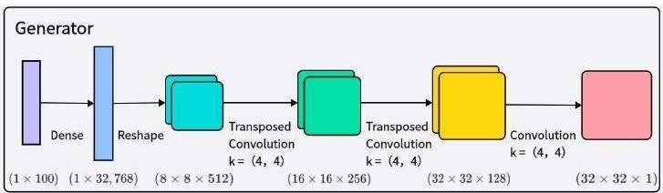
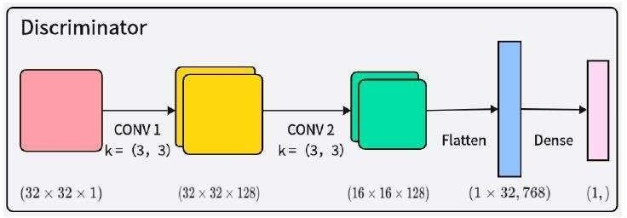
DATA AUGMENTATION USING CGAN :-

Slide 20
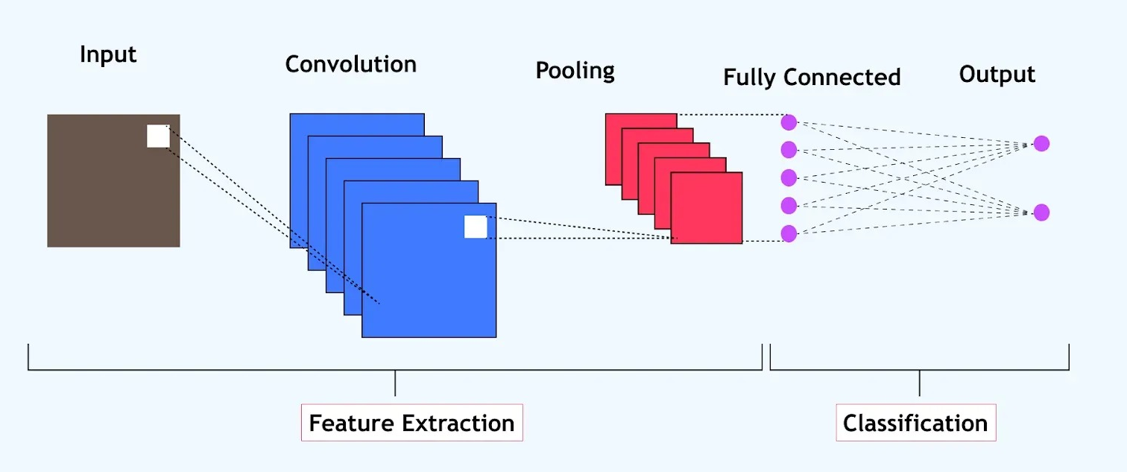
ARCHITECTURE OF CNN :-
REAL + SYNTHETIC DATA
ACCURACY

Slide 21
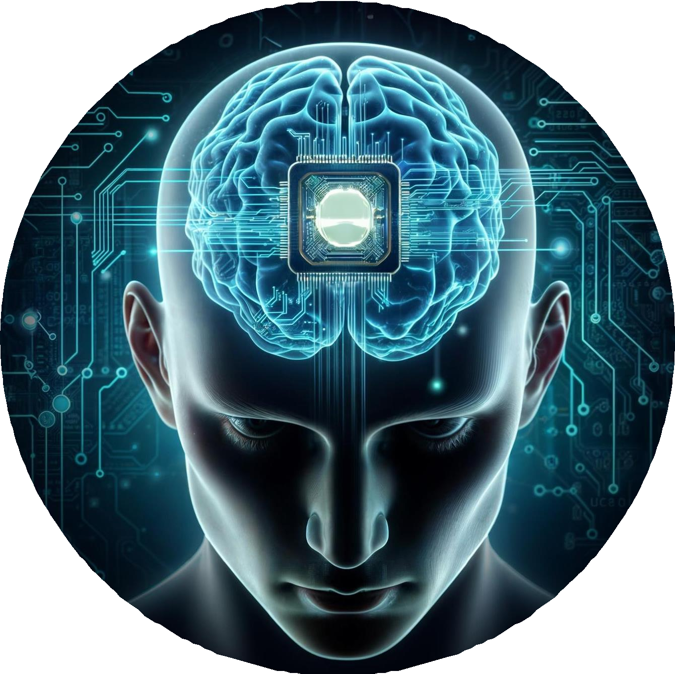
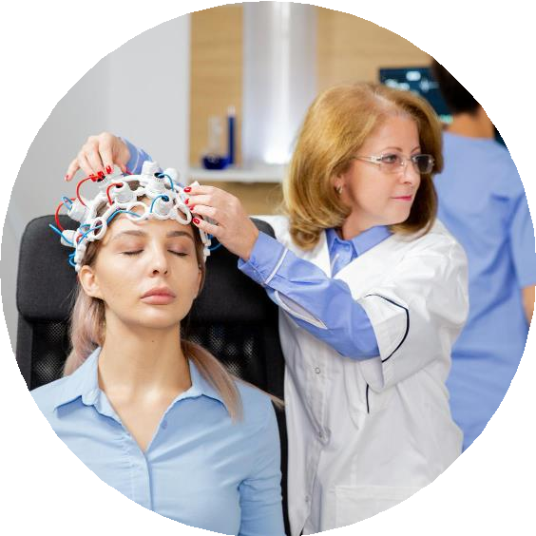
BLOCK DIAGRAM OF THE PROCESS :-
SIGNAL ACQUISITION
CGAN MODAL DESIGN
DATA PREPROCESSING
ML & DL CLASSIFICATION
FEATURE EXTRACTION
PERFORMANCE EVALUATION

Slide 22
DATASET :-
MI – EEG & MI – FNIRS
https://www.sicotj.org/articles/sicotj/full_html/2021/01/sicotj210087/sicotj210087.html
MI – EEG & COGNITIVE – FNIRS
https://www.kaggle.com/datasets/thngdngvn/bci-competition-iv-data-sets-2a
COGNITIVE – EEG & COGNITIVE – FNIRS
https://pubmed.ncbi.nlm.nih.gov/38533112/

Slide 23
Data Preprocessing :-
EEG Processing :-
Bandpass Filtering :
Removes unwanted noise (e.g., muscle artifacts, power-line interference).
fNIRS Processing :
Baseline Normalization:
Ensures consistency in hemoglobin signals.

Slide 24
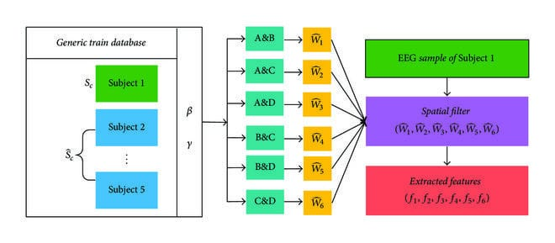
Feature Extraction :-

Slide 25
Feature Extraction :-
EEG :
Common Spatial Patterns (CSP):
Improves discrimination of motor imagery classes.
Wavelet Transform:
Captures both time and frequency domain features.
fNIRS:
Hemodynamic Response Features:
Extracts oxygenated (HbO) and deoxygenated hemoglobin (HbR) variations.

Slide 26
cGAN Model Design :-
Traditional data augmentation (e.g., noise addition) is limited.
cGAN generates realistic synthetic EEG-fNIRS data conditioned on class labels.
Model Components :
Generator (G):
Takes a random noise vector + class label and outputs synthetic EEG-fNIRS signals.
Discriminator (D):
Differentiates between real and synthetic signals.

Slide 27
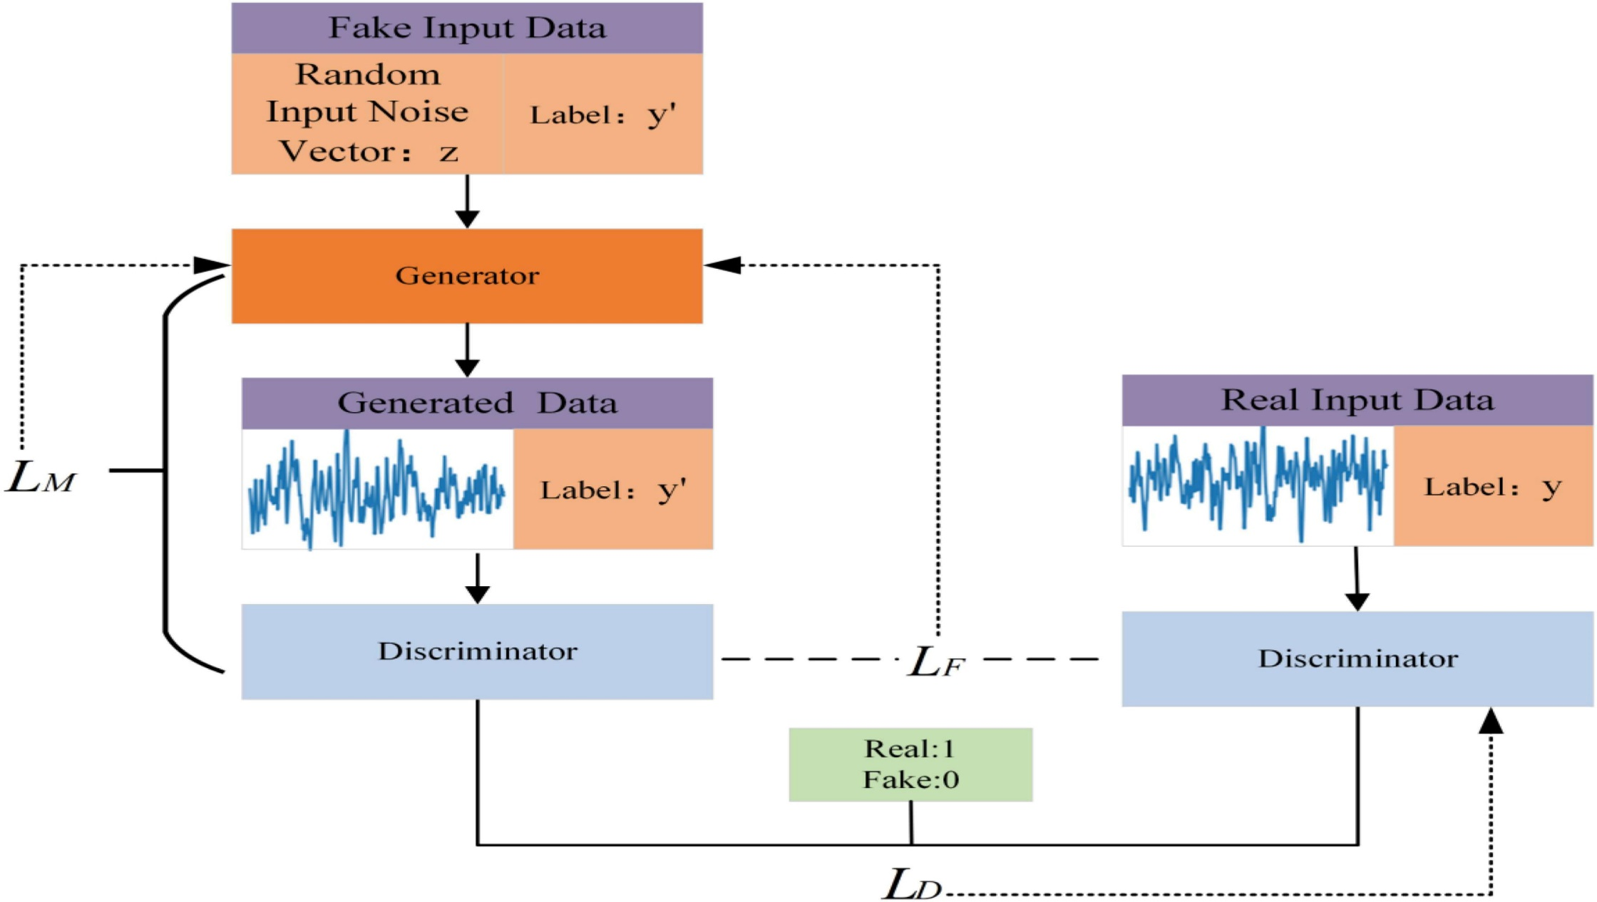
CGAN PROCESS :-
Fusion of real and synthetic data

Slide 28
Model Training :-
Training the cGan :
Optimize Generator so that it can fool the Discriminator .
Optimize Discriminator (D) to improve classification of real vs. fake data.
Loss Functions ensure both networks improve iteratively.
Synthetic Data Generation :-
Generating EEG-fNIRS Data :
Use trained cGAN to generate new brain signals.
Conditioned on class labels (e.g., left-hand, right-hand movement).

Slide 29
Deep Learning Classification :-
Train deep learning models on real + synthetic data :
CNN (for spatial features).
Compare performance :
Without synthetic data(baseline).
With cGAN-augmented data* (improved accuracy).

Slide 30
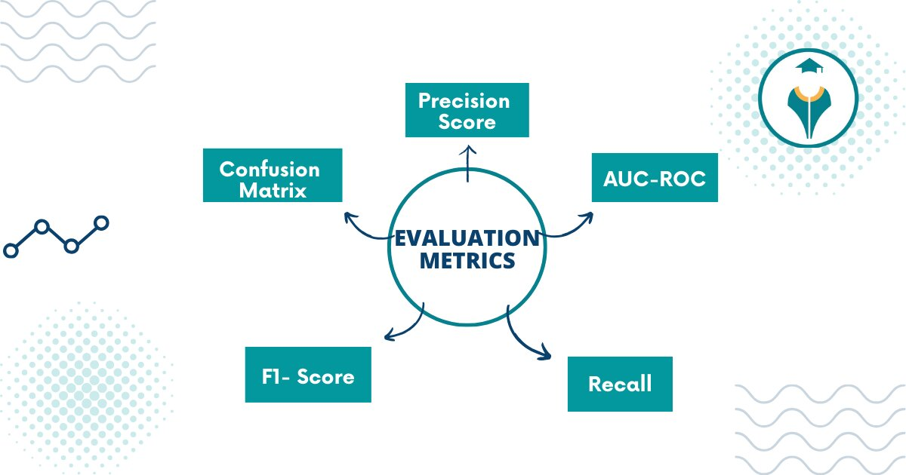
Performance Evaluation :-
Accuracy Improvement :
Synthetic data helps improve BCI classification by 5-10%.
Statistical Similarity :
t-SNE visualization shows real & synthetic data cluster together, confirming realism.

Slide 31
Classification Metrics:
1. Accuracy: Accuracy = (TP + TN) / (TP + TN + FP + FN)
2. Precision: Precision = TP / (TP + FP)
3. Recall: Recall = TP / (TP + FN)
4. F1-Score: F1-Score = 2 * (Precision * Recall) / (Precision + Recall)
Multi-Class Classification Metrics:
1. Confusion Matrix: A table used to evaluate the performance of a classification model.
2. Classification Accuracy: Accuracy = (∑ diagonal elements of confusion matrix) / (∑ all elements of confusion matrix)

Slide 32
Conclusion :-
Findings :
Deep learning models (CNN) trained with synthetic data showed higher accuracy than models trained only on real data.Accuracy gain: 5-10% improvement after augmenting using CGAN training data with synthetic EEG-fNIRS signals.Hybrid EEG-fNIRS models outperformed EEG-only models, proving the advantage of using multi-modal data.Model Without Augmentation with cGAN AugmentationCNN (EEG-only)75%

Slide 33
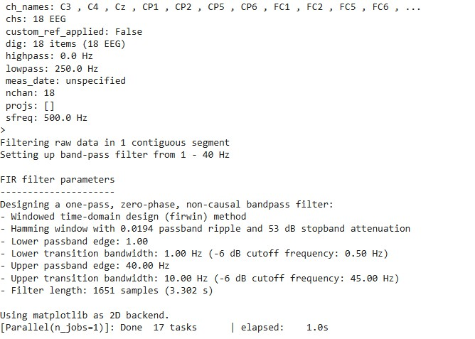
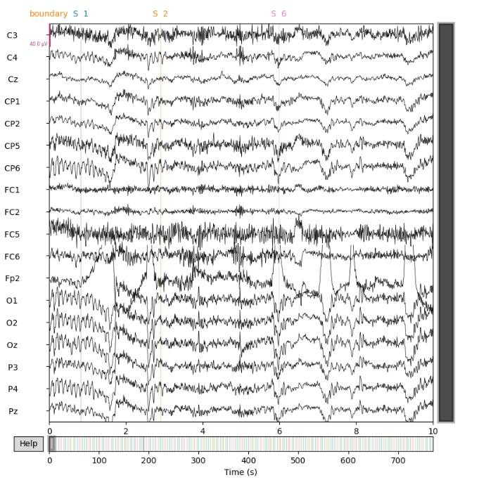
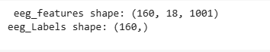
MI – EEG & MI – FNIRS :-

Slide 34
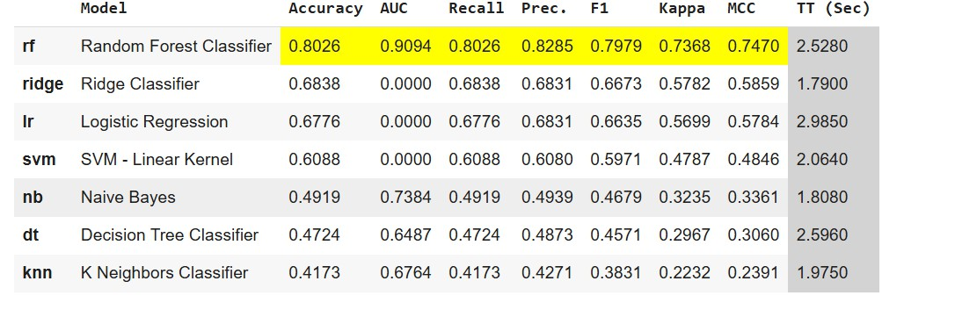

OUTPUT :-
5/5 ━━━━━━━━━━━━━━━━━━━━ 0s 87ms/step - accuracy: 0.8239 - loss: 1.1418
20/20 ━━━━━━━━━━━━━━━━━━━━ 2s 90ms/step - accuracy: 1.0000 - loss: 0.0029
🔹 CNN Test Accuracy using the raw data: 0.8342
🔹 CNN Train Accuracy using the raw data: 1.0000

Slide 35
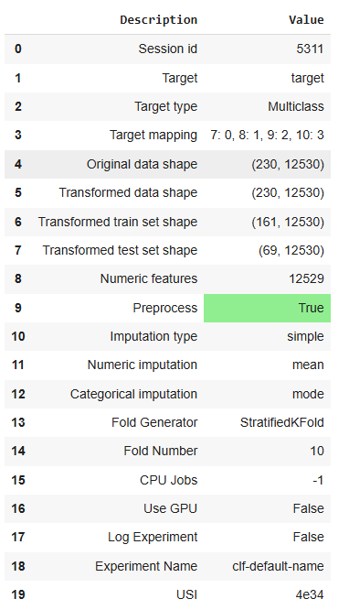
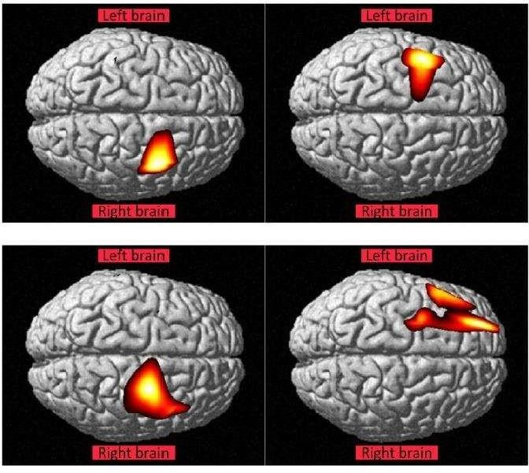
MI – EEG & COGNITIVE– FNIRS :-

Slide 36
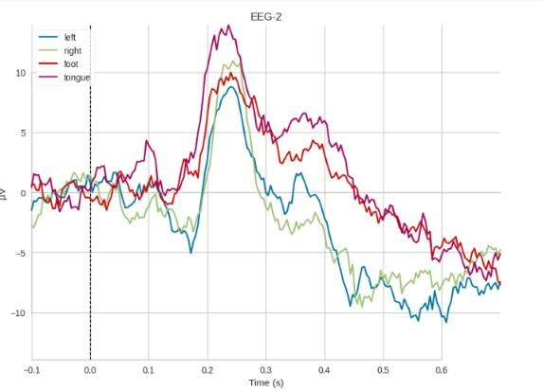
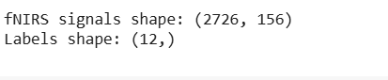
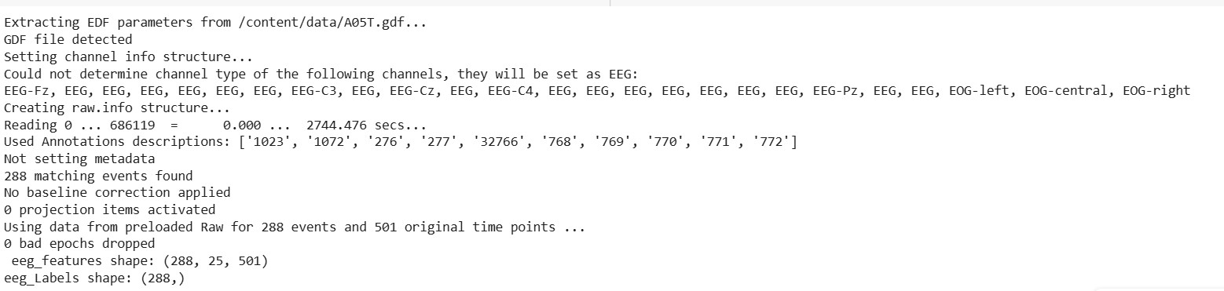
MI – EEG & COGNITIVE– FNIRS :-

Slide 37
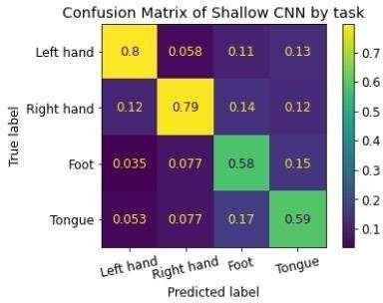
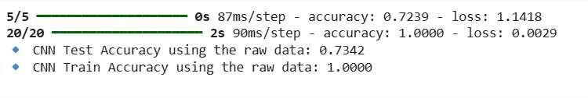
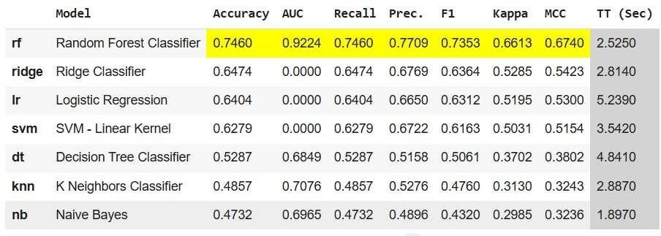
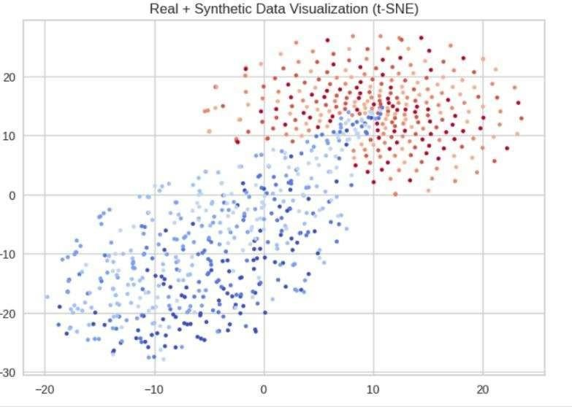
OUTPUT :-

Slide 38
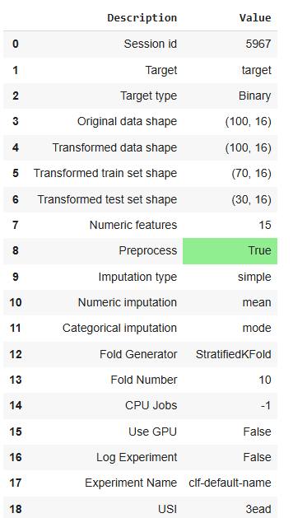
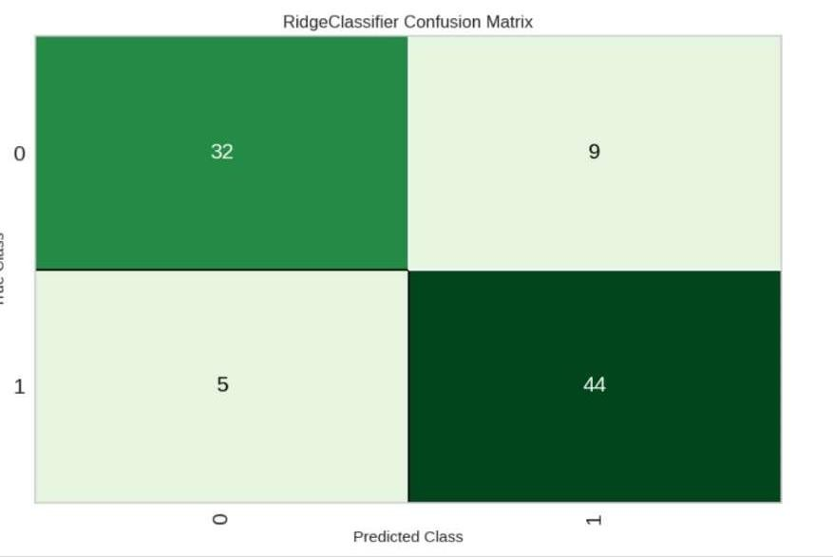
COGNITIVE – EEG & COGNITIVE – FNIRS :-

Slide 39
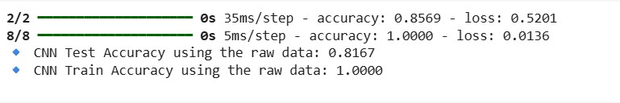
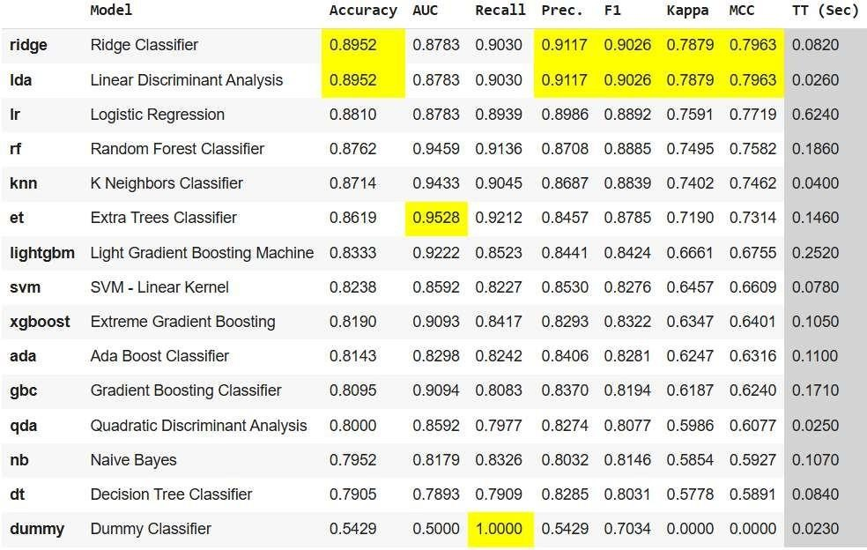
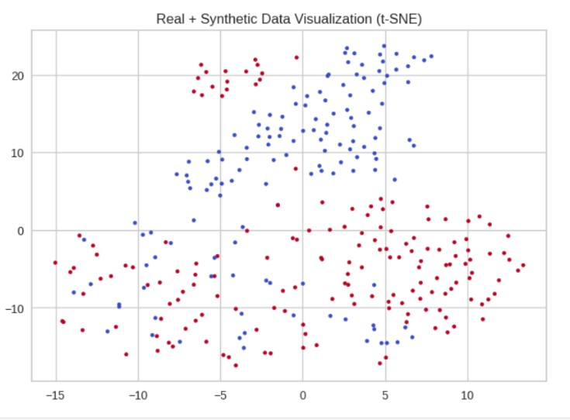
OUTPUT :-

Slide 40
RESULT:-
Robustness Against Data Limitations :-
GAN-augmented training sets mitigated the problem of limited BCI training data.Reduced overfitting in deep learning models due to increased data diversity.Models generalized better across subjects, handling inter-subject variability more effectively.
Potential for Real-Time BCI Systems :-
The project demonstrated that cGAN-generated data can be used in real-time BCI applications.Future scope includes:
Subject-specific cGANs —› Personalizing augmentation for individual users.
Adaptive BCI training —› Continuous learning to adapt to user-specific brain activity changes.

Slide 41
RESULT :-
TYPES OF INTEGRATION | CNN ACCRURACY WITHOUT AUGMENTATION | CNN ACCRURACY WITH AUGMENTATION (CGAN MODAL)
MI-EEG & MI-fNIRS | 60% | 84%
MI-EEG & COGNITIVE-fNIRS | 56% | 73%
COGNITIVE-EEG & COGNITIVE-fNIRS | 50% | 81%

Slide 42
RESULT :-
TYPES OF INTEGRATION | BEST CLASSIFIERS (ML CLASSIFIERS) | ACCRURACY WITHOUT AUGMENTATION | ACCRURACY WITH AUGMENTATION (CGAN MODAL)
MI-EEG & MI-fNIRS | Random forest classifier | 63% | 80%
MI-EEG & COGNITIVE-fNIRS | KNN & Random forest classifier | 50% | 73%
COGNITIVE-EEG & COGNITIVE-fNIRS | Ridge classifier | 72% | 90%

Slide 43
RESULT :-
TYPES OF INTEGRATION | BEST CLASSIFIERS (ML CLASSIFIERS) | AUC WITHOUT AUGMENTATION | AUC WITH AUGMENTATION (CGAN MODAL)
MI-EEG & MI-fNIRS | Random forest classifier | 80% | 94%
MI-EEG & COGNITIVE-fNIRS | Random forest classifier | 64% | 92%
COGNITIVE-EEG & COGNITIVE-fNIRS | Random forest classifier & Extra tree classifier | 65% | 95%

Slide 44
RESULT:-
TYPES OF INTEGRATION | BEST CLASSIFIERS (ML CLASSIFIERS) | F1 SCORE WITHOUT AUGMENTATION | F1 SCORE WITH AUGMENTATION (CGAN MODAL)
MI-EEG & MI-fNIRS | Logistic regression & Random forest classifier | 72% | 79%
MI-EEG & COGNITIVE-fNIRS | KNN & Random forest classifier | 41% | 73%
COGNITIVE-EEG & COGNITIVE-fNIRS | Dummy classifier & Ridge classifier | 76% | 95%

Slide 45
OUTPUT :-

Slide 46
REFERENCE :-
tao xu,zhengkang zhou,yuliang yang,yuli,junhuali(20 June 2023). Motor
imagery decoding enhancement based on hybrid EEG-FNIRS signals.
Xiuli du,Xiaohui ding,meiling xi,yana lv,shaoming qui and qingli liu(12 April 2024). A data augmentation method for motor imagery EEGsignals based on DCGAN-GP network
Krish kabra,Daniel truong,calvin chang(2022). Improving motor imagery classification using generative models and artificial EEG signals.
Jiuxiang song,qiang zhai,chang wang and jizhong liu(21 June 2024). EEGGAN-NET:enhancing EEGsignal classification through data augmentation.

Slide 47
REFERENCE :-
Khan, M. J., Hong, M. J., and Hong, K.-S.(2014). Decoding of four movement directions using hybrid NIRS-EEGbrain-computer interface. Front. Hum.Neurosci. 8:244. doi: 10.3389/fnhum.2014.00244
Muhammad salman khan(2021). EEG-Fnirs data augmentation using cGANs.
Saeed anwar( 2023). Deep generative models for EEG-FNIRSfusion.
Yong zhang.(2022). Cross model data augmentation for BCI.

Slide 48
THANK YOU

